Slide 1

Data Handling

Slide 2
Contents
Data Types
Numbers
Strings
Lists
Tuples
Dictionary
Set
Frozenset
Bool
Mutable and Immutable

Slide 3
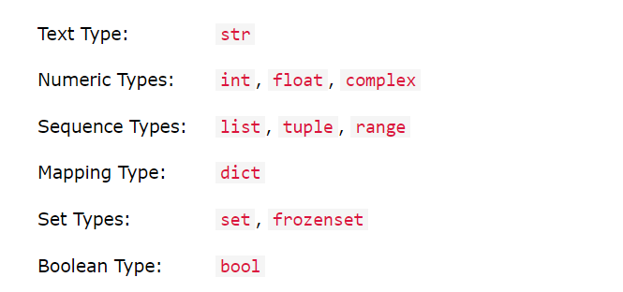
Data Types
Data types are the classification or categorization of data items.
There are 7 Data types in Python

Slide 4

Getting Data Type
You can get the data type of a variable using type() function.

Slide 5
Exercise - Print Type of a variable.
As we said earlier we can assign various type of values in a variable,
eg:
x = “hello python” (String)
y = 123 (int)
z = 1.23 (float)
a = true (Boolean)
b = “1234” (String)
print(x,y,z,a,b)
In this example,
x is a string type, y is an integer, z is float, a will be boolean, b is string
if we need the type of this to print then we can use an reserved word, that will be type().
print(type(y))
output will be:
Class int

Slide 6
Values stored in variables can be used to do operations
we use operators like +,-,*,/,% inside some variables to get some value and assigning to that .
these are basic Arithmetic operators which we use in python programing languages.
each has a specific function which we use when we do programming.
+ for addition.
- for subtraction.
* for multiplication.
/ for division.
% for getting reminder which is called modulus operator.
we will deal detailed view of operators in later classes.

Slide 7
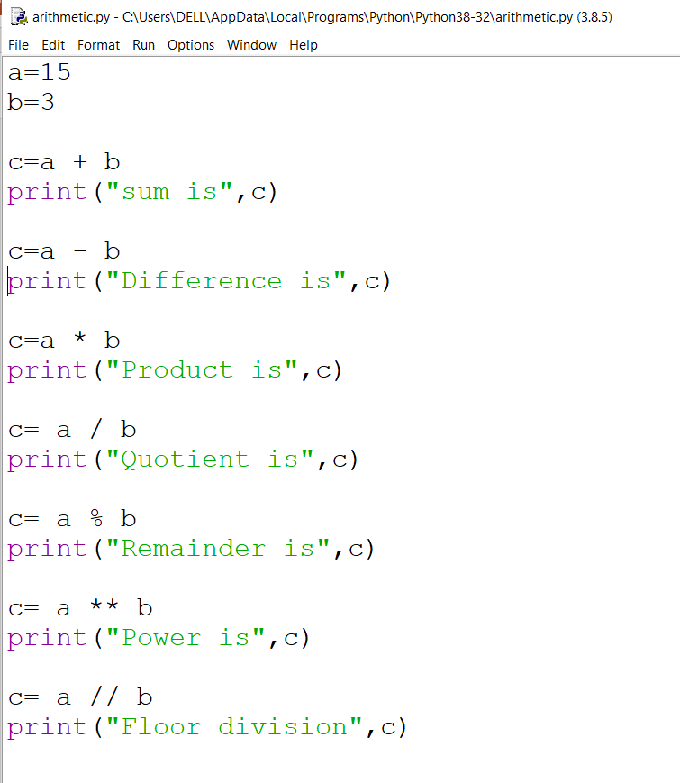
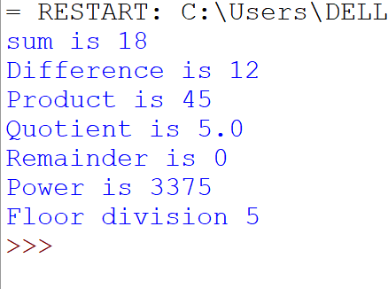
Exercise – Using variables - Operators

Slide 8
Getting input from the user
A = int(input(“Enter first number”))
B = int(input(“Enter second number”))

Slide 9
Conversion from one data type to another
we will see about conversion .
on the image we can see the
conversion methods.
eg :
x = 123
print(x)
this will be an integer output,what if the first command we use,which is
print(str(x))
then we get an string output. we can check what type it is, with type().

Slide 10
Exercise
Find out area of a Rectangle
Find out perimeter of a Rectangle
Find out area of circle
Find out perimeter of a Circle

Slide 11
Question
Print current date and time
import datetime
now = datetime.datetime.now()
print ("Current date and time : ")
print (now.strftime("%Y-%m-%d %H:%M:%S"))

Slide 12
To get version of python
import sys
print("Python version")
print (sys.version)

Slide 13
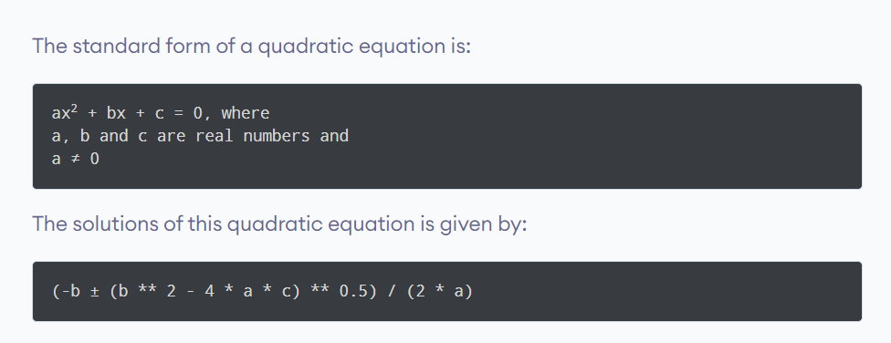
Solve the quadratic equation

Slide 14
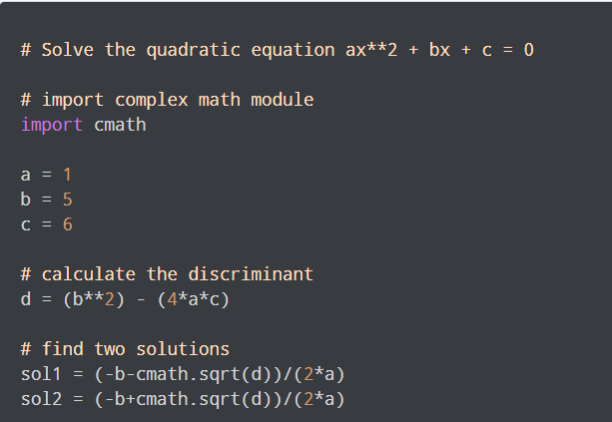
Solution

